Slide 1
Module 2
Premanand S

Slide 2
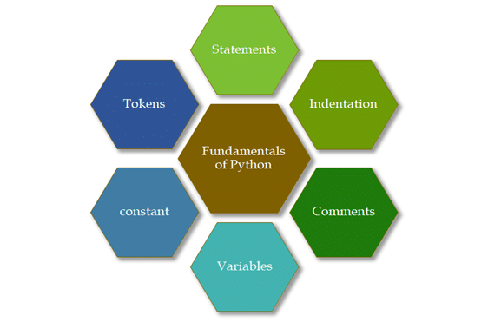
Module 2
Python Programming Fundamentals
Introduction to Python
Interactive and Script mode
Indentation
Comments
Variables
Reserved words
Data Types
Operators and their precedence
Expressions
Built in functions
Importing from packages

Slide 3
Introduction to Python

Slide 4
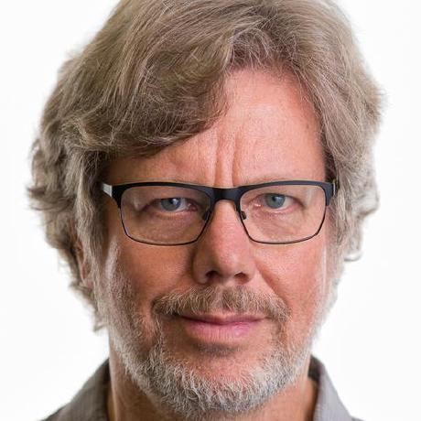
Basics
General Purpose
High Level Programming Language
Dynamically-typed
Named after Monty Python’s Flying Circus
Guido Van Rossum
1991

Slide 5
Importance
Works in different platform / OS
Syntax is simple like English
Few lines of code
New line means end of the command
Runs in interpreter system
.py or .ipynb

Slide 6
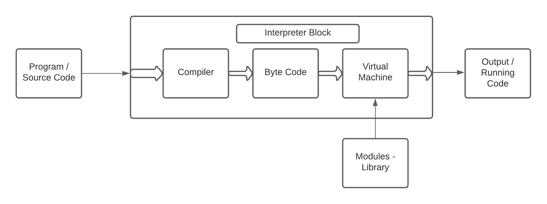
Architecture & Working
Read – Evaluate – Print – Loop
Lexing – Line code to Token
Parsing – Token to structure (Abstract Syntax Tree)
Compiling - Abstract Syntax Tree to Code objects
Interpreting – Executes each object

Slide 7
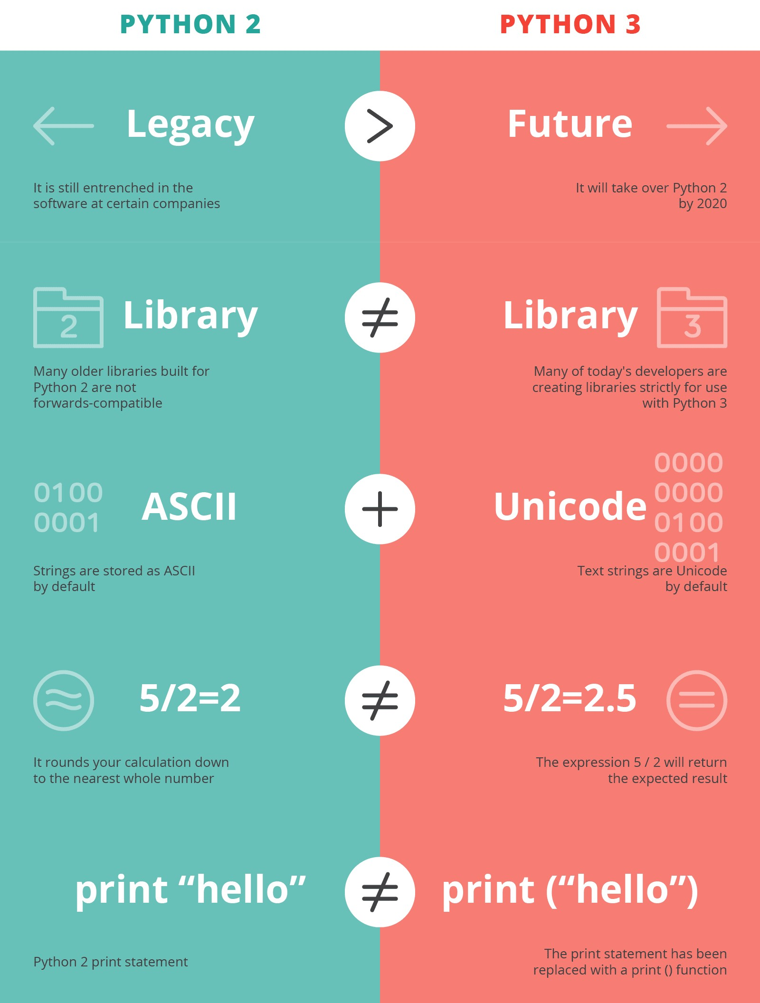
Version difference

Slide 8
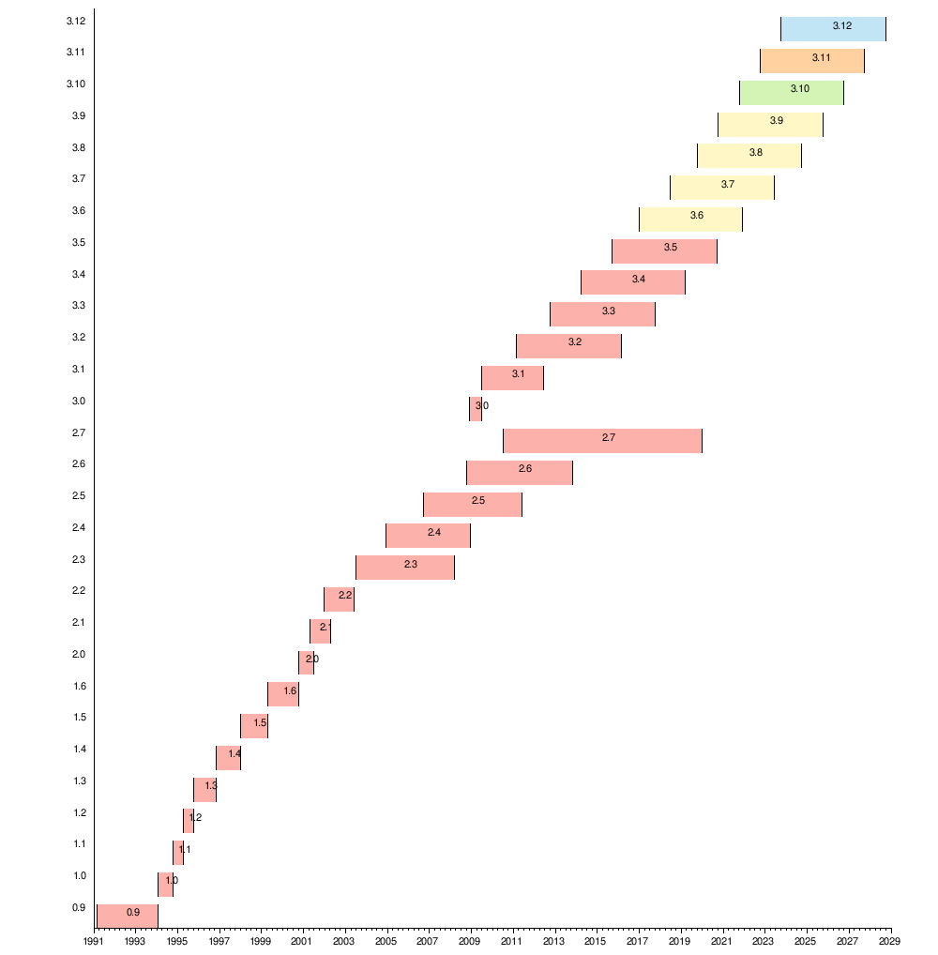
Python - Future
Python 3.14 will be faster than C++
https://towardsdatascience.com/python-3-14-will-be-faster-than-c-a97edd01d65d

Slide 9
Fun facts
Hobby project
The name Python?
Python overtakes French in school, UK
Flavors of Python – Cpython, Jpython, Micro Python,
Ruby Python, Brython
Tech giants - MANG
Multiple assignments in a single line
Import antigravity

Slide 10
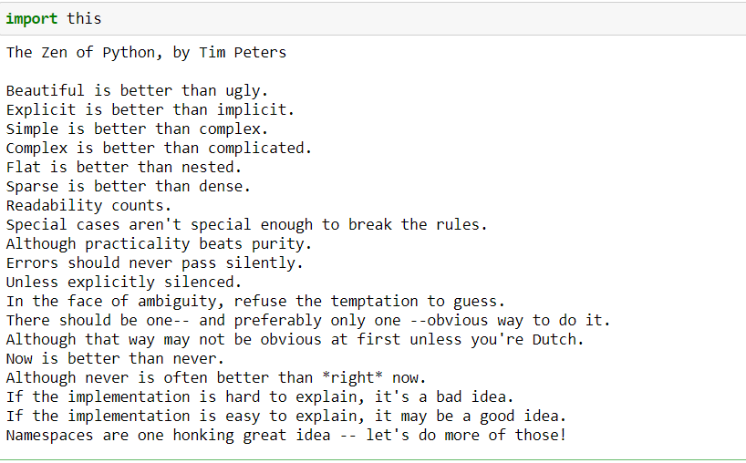
Poetry – Python | Zen of Python

Slide 11
Download!
https://www.python.org/
https://www.python.org/downloads/release/python-370/
IDE - Coding tool which allows you to write, test, and debug your code in an easier way

Slide 12
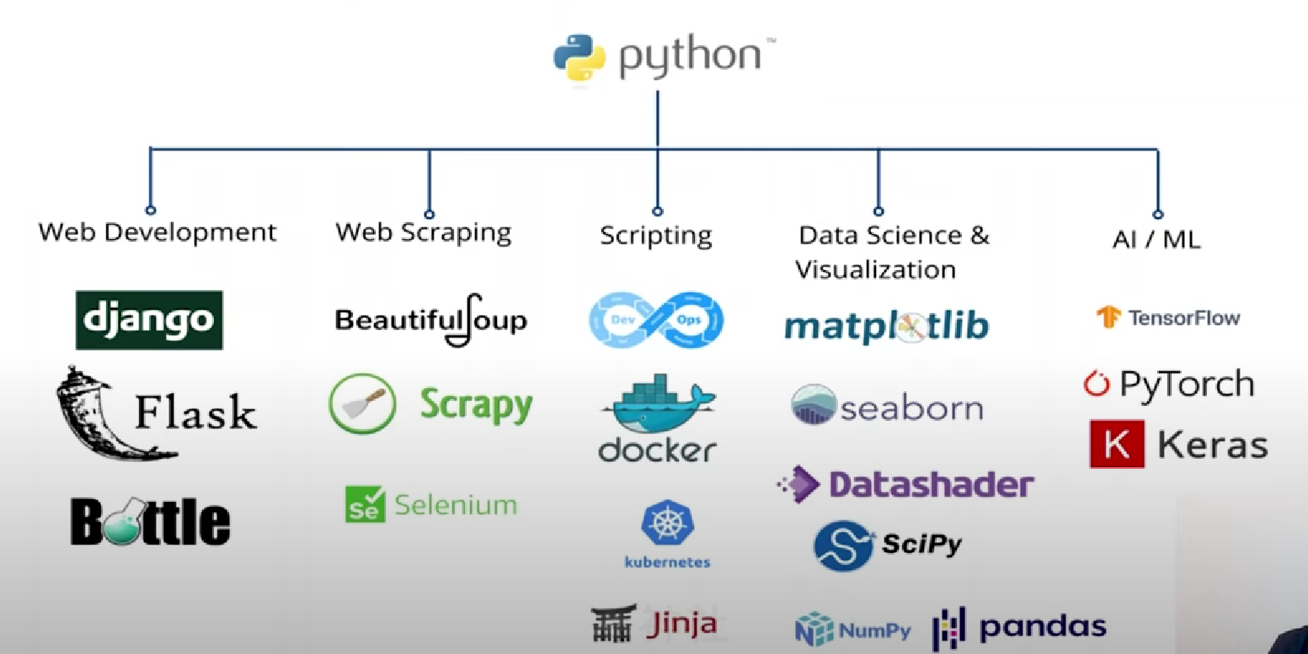
Python - Applications

